Slide 1
Listen and Don’t Forget Bro!:
An FPGA-Based Memory Game
ECE 5440
Advanced Digital Design
Dr. Yuhua Chen
4/30/20

Slide 2





Shasta GuideBot Model S
Leandro Viray
Shivam Patel
Emilio Baguioro
Rafael Medina
Son Doan
Electrical Engineer
Electrical Engineer
Computer Engineer
Computer Engineer
Computer Engineer

Slide 3
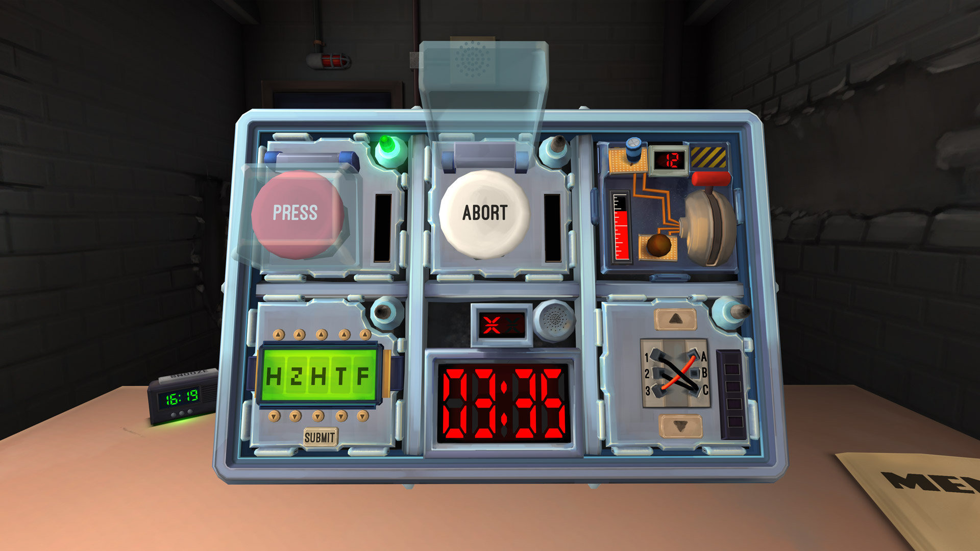
What is Listen and Don’t Forget Bro!: An FPGA-Based Memory Game?

Slide 4





Division of Labor
Game Design
Score Tracking
Top Level Module
Access
Timer
RNG and Verification

Slide 5
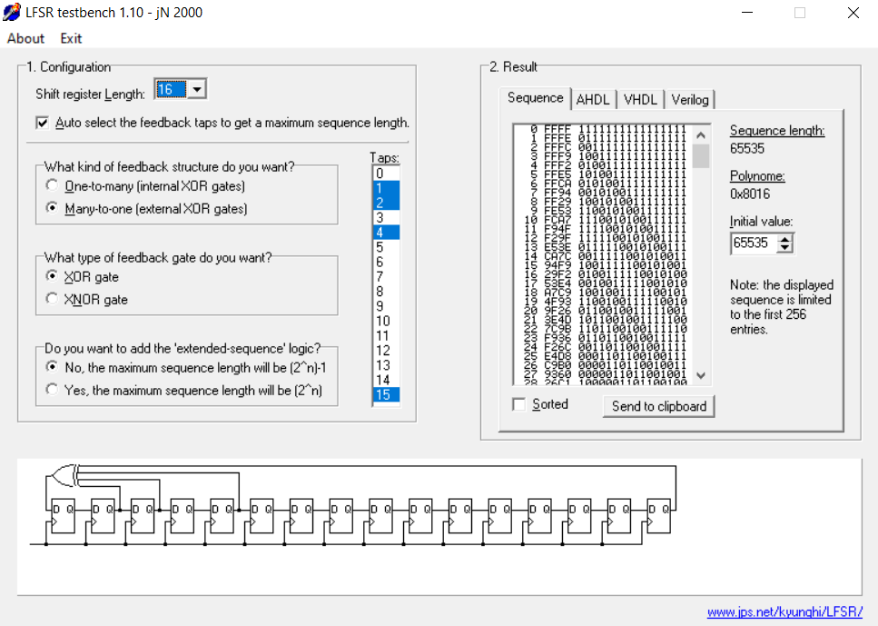
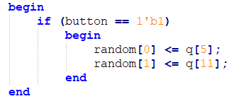
LFSR-Based Random Number Generator

Slide 6
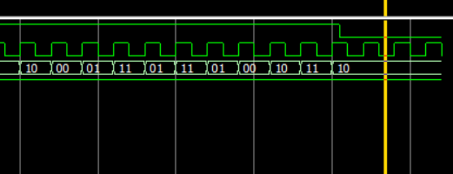
LFSR-Based Random Number Generator

Slide 7
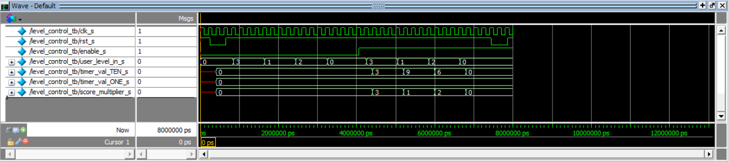
Game Level Control
timer_TENS_val
user_level_input
level_ctrl_module
timer_ONES_val
enable
score_multiplier

Slide 8
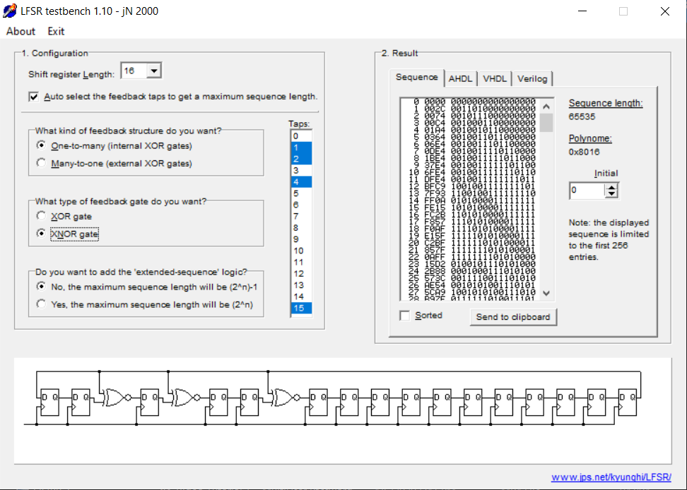
LFSR-Based Timer

Slide 9
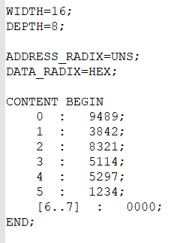
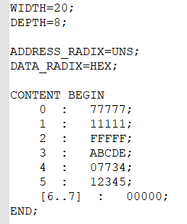
ROM-Based Multi-User Authentication

Slide 10
ROM-Based Multi-User Authentication (ID)
rst == 0
push == 1
push == 1
push == 1
s_ram_init
s_enter_id_1
s_enter_id_2
s_enter_id_3
s_enter_id_4
address_id == 3’b111
id == rom
s_done_id
s_compare_id
s_rom_id
s_wait_2_id
s_wait_1_id

Slide 11
ROM-Based Multi-User Authentication (Password)
push == 1
push == 1
push == 1
push == 1
s_enter_ pass_1
s_enter_ pass_2
s_enter_ pass_3
s_enter_ pass_4
s_enter_ pass_5
pass != rom && retry < 2’b10
pass == rom
s_done_pass
s_compare_ pass
s_rom_pass
s_wait_2_ pass
s_wait_1_ pass

Slide 12
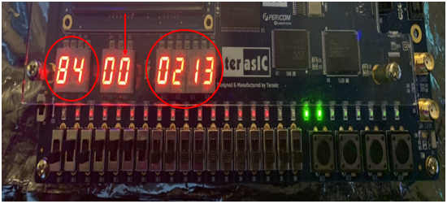
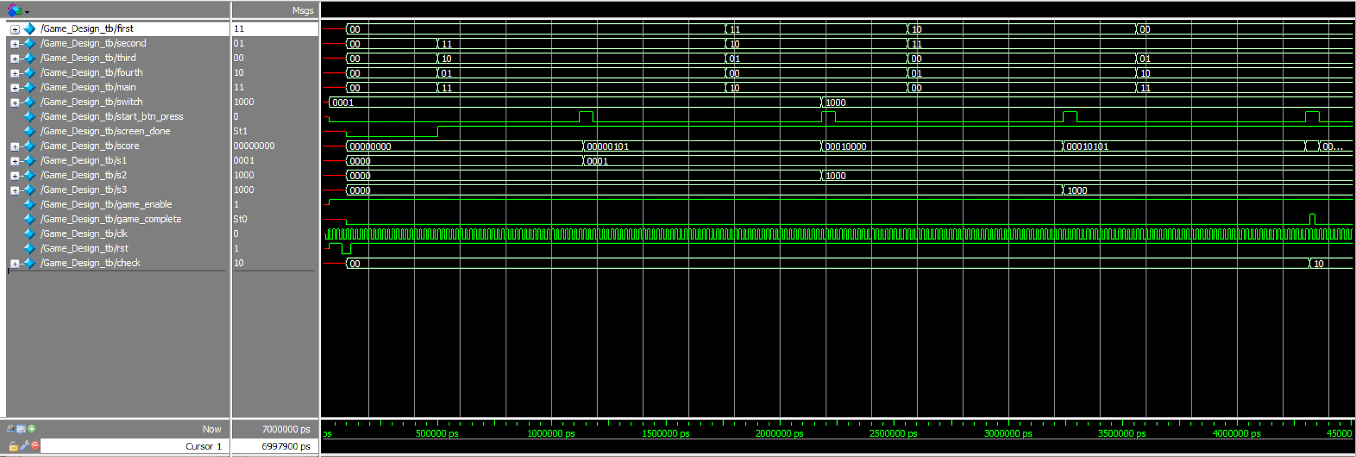
Game Design

Slide 13
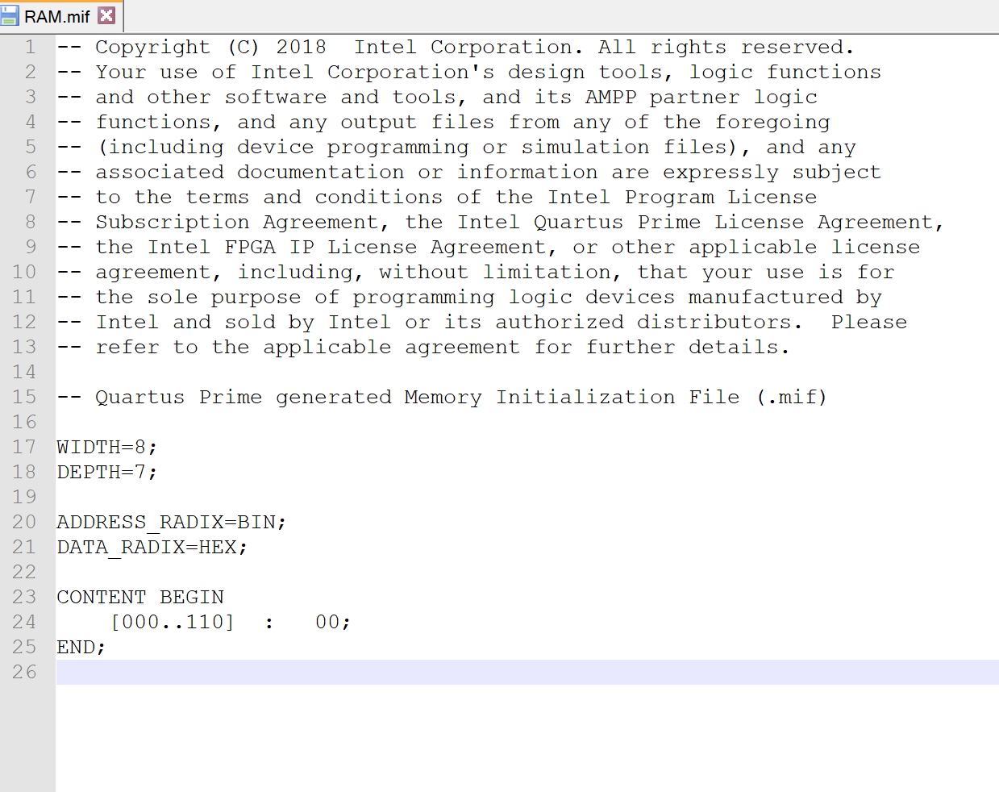
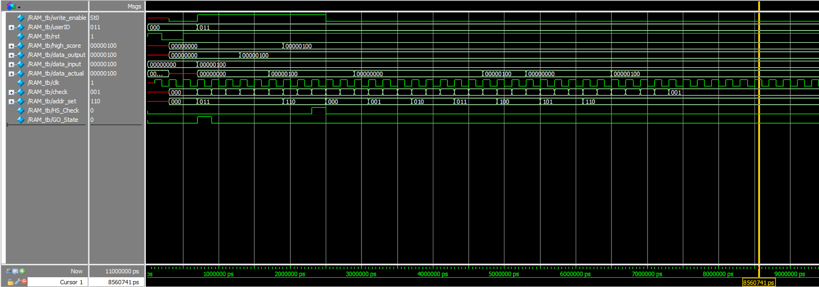
Player Score Tracking (RAM)

Slide 14
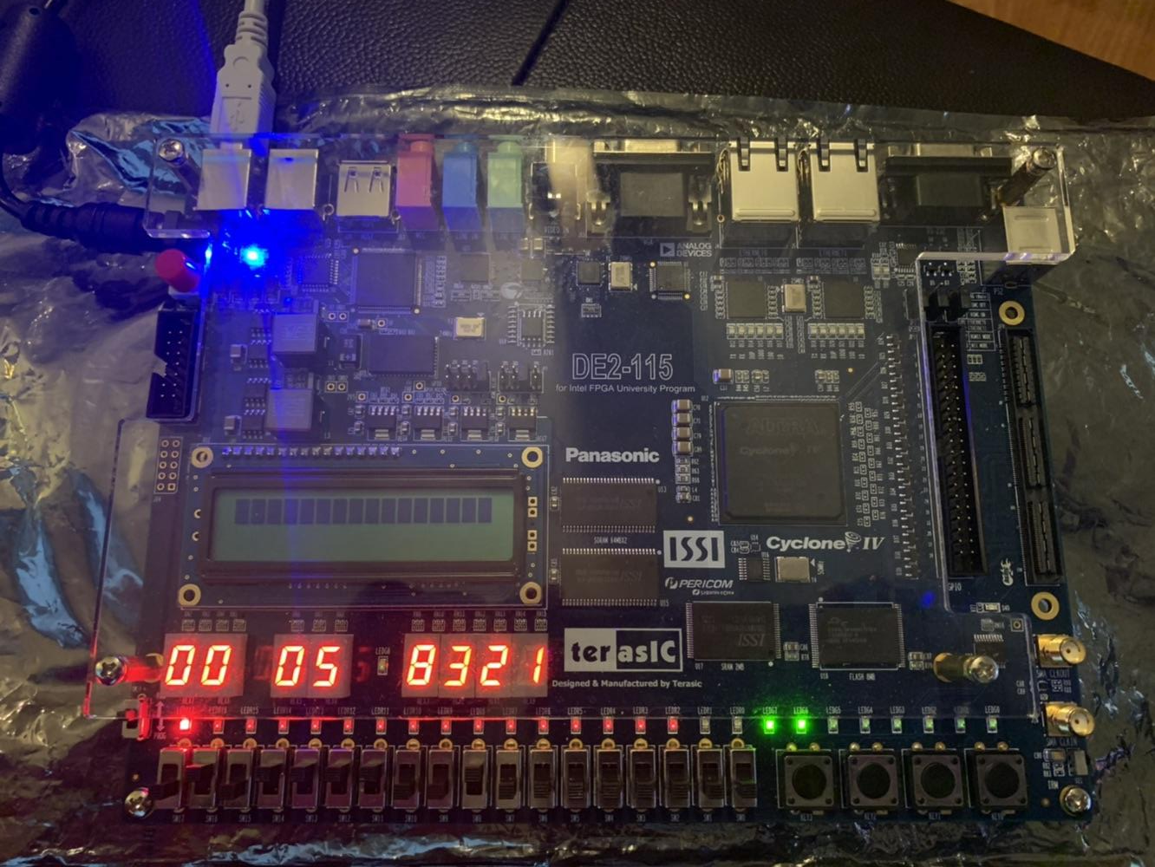
Max Score (RAM)

Slide 15
Game Scenarios
Stage 1: If the display is 0, flip up the 2nd switch. If the display is 1, flip up the 2nd switch. If the display is 2, flip up the 3rd switch. If the display is 3, flip up the 4th switch
Stage 2: If the display is 0, flip up switch under display showing “3”. If the display is 1, flip up the switch you flipped up in stage 1. If the display is 2, flip up the 1st switch.. If the display is 3, flip up the 2nd switch.

Slide 16
Game Scenarios
Stage 3: If the display is 0, flip up the switch you flipped in stage 2. If the display is 1, flip up the switch you flipped in stage 1. If the display is 2, flip up the 3rd switch. If the display is 3, flip up switch under display showing “3”. ..
Stage 4: If the display is 0, flip up the switch you flipped in stage 1. If the display is 1, flip up the 1st switch. If the display is 2, flip up the switch you flipped in stage 2. If the display is 3, flip up the switch you flipped in stage 3

Slide 17
Hardware Setup
2 seven-segment displays = digit timer
1 seven-segment display = id/password entry
6 seven-segment displays = max score
1 red LED = incorrect id
1 green LED = correct id 1 green LED = correct password 1 red LED = incorrect password 1 red LED = timeout
2 switches = difficulty
4 switches = player input
4 switches = id/password entry
1 button = reset
1 button = login/reconfig/game start
1 button = max score
1 button = player input/logout

Slide 18
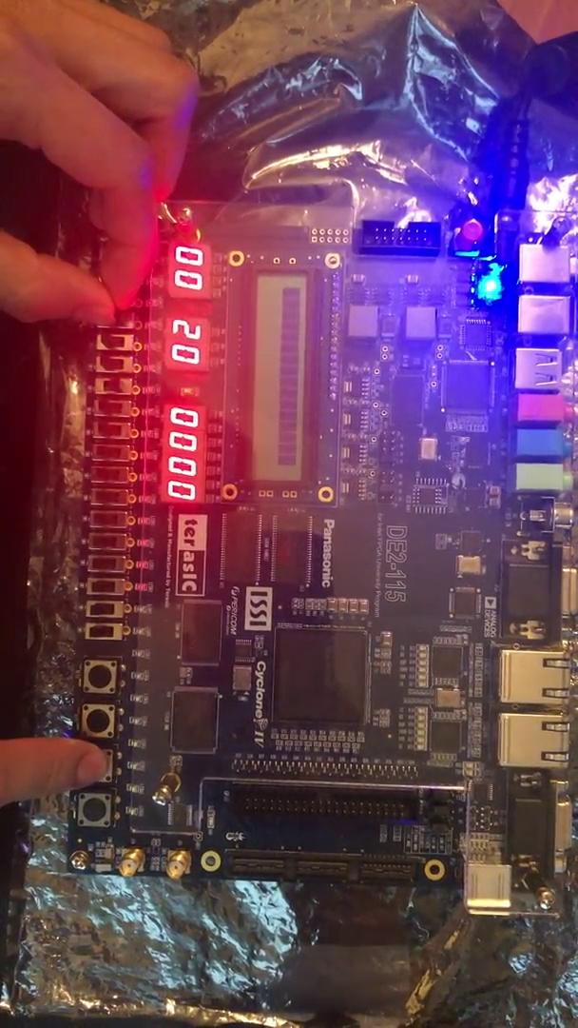
Video Demonstration (Part 1)

Slide 19
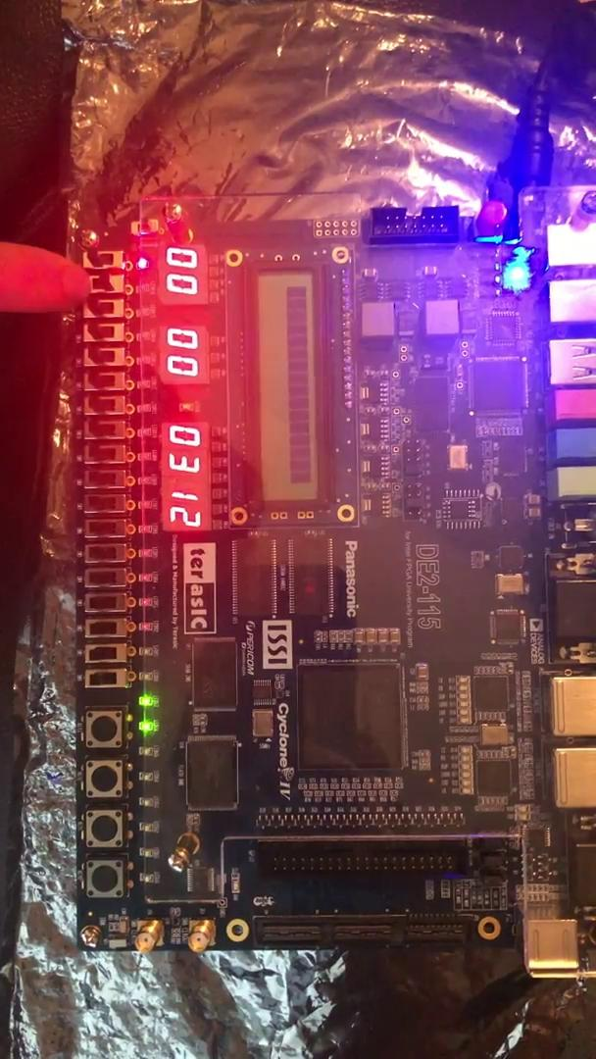
Video Demonstration (Part 2)

Slide 20
Questions?

